Slide 1

Exploratory Data Analysis
Bank Marketing Campaign
11/16/2022

Slide 2
Agenda
Executive Summary
Problem Statement
Approach
EDA
EDA Summary
Recommendations

Slide 3
Executive Summary
Background Information:
Analysis for ABC to provide insight based on customer’s past interactions with previous marketing campaigns.
Objective:
Procure information from Portuguese banking institutions to create a model to forecast buying trends in their term deposit product.

Slide 4
Problem Statement
& Approach
This analysis will provide insight for the ABC Bank campaign for the term deposit product based on the data provided from past marketing campaigns of another Portuguese banking institution. Metrics include customer demographics, banking information, and customer interaction with the previous campaign.

Slide 5
Exploratory
Data Analysis
Features present in the dataset:
age
job
marital
education
default
balance
housing
loan
contact
day
month
duration
campaign
pdays
previous
poutcome
y (Target)

Slide 6
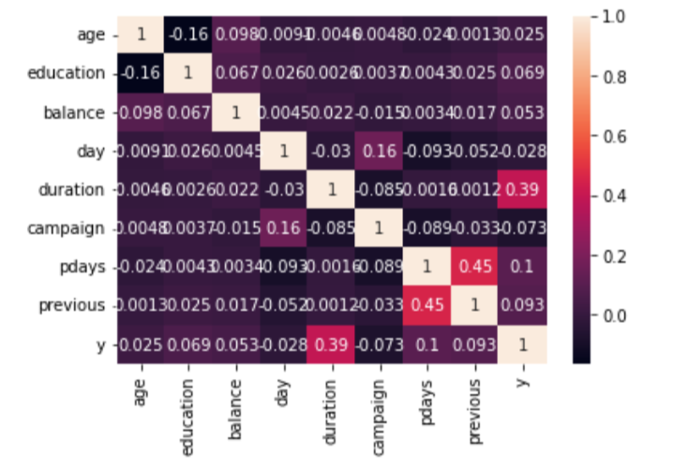
Exploratory Data Analysis
Hypothesis 1
The correlation value between the numeric columns and the outcome column(y) were evaluated.
Little to no correlation between columns and the outcome other than the duration column.
Moved on to look at correlation between categorical variables and the outcome column
Heatmap of correlations between numeric correlations

Slide 7
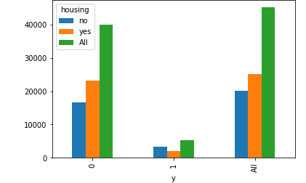
Exploratory Data Analysis
Hypothesis 1
To investigate the correlations between categorical variables a bar chart is used
The figure shows how more people have housing loans for people that don’t subscribe and more people don’t have housing loans for people that do subscribe
Chi squared test was run between the variables to check for correlation
Null hypothesis of there is no correlation between the variables is rejected suggesting that the housing variable is an important feature for the model
This figure displays a bar chart of the housing and outcome variables

Slide 8
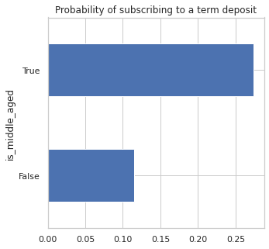
Exploratory Data Analysis

Slide 9
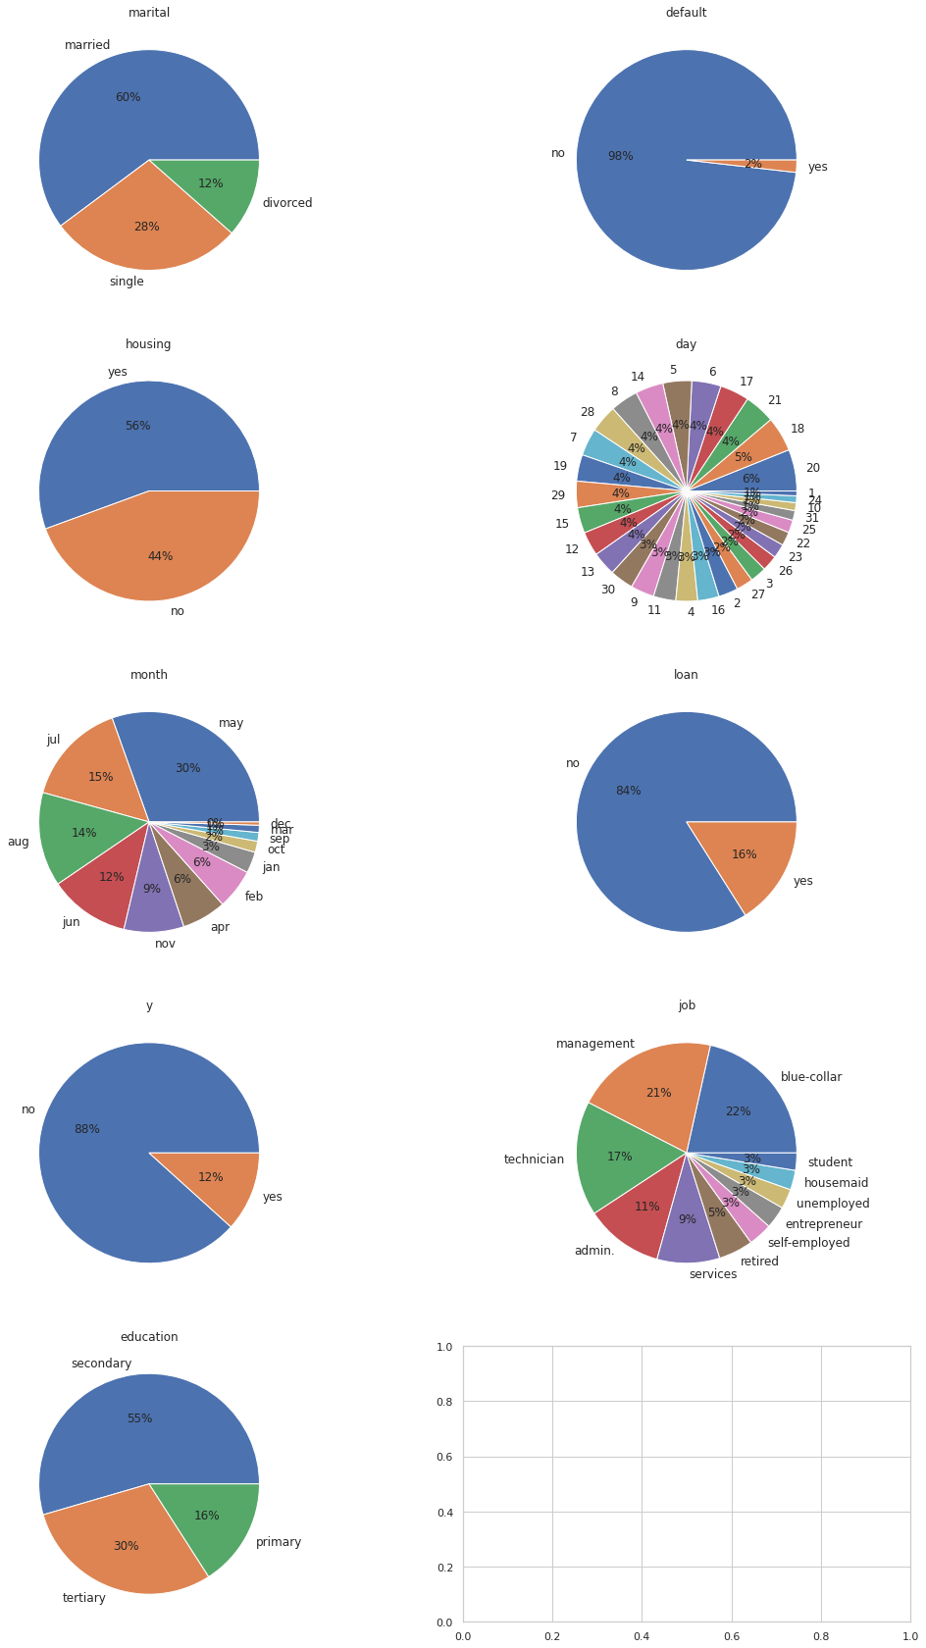
Exploratory Data Analysis
60% of the individuals are married and there are 12% divorced individuals.
The default has a mere 2% ‘Yes’ and the remaining 98% as ‘No’.
56% of the individuals have a housing loan..
The last contact day is evenly distributed as seen in the pie chart.
The number of people that has been contacted in the month of May is highest with 30% followed by the month of july.
84% of people do not have the personal loan while 16% of individuals do not have the personal loans.
Most of the individuals in the dataset have a blue collar whose percentage is 22% which is followed by management with 21% The technicians take the third spot with 17% and the remaining jobs are distributed with very percentage.
Most of the individuals have secondary education and constitute 55% while 30 % have advance education and the .remaining 16% have primary education.

Slide 10
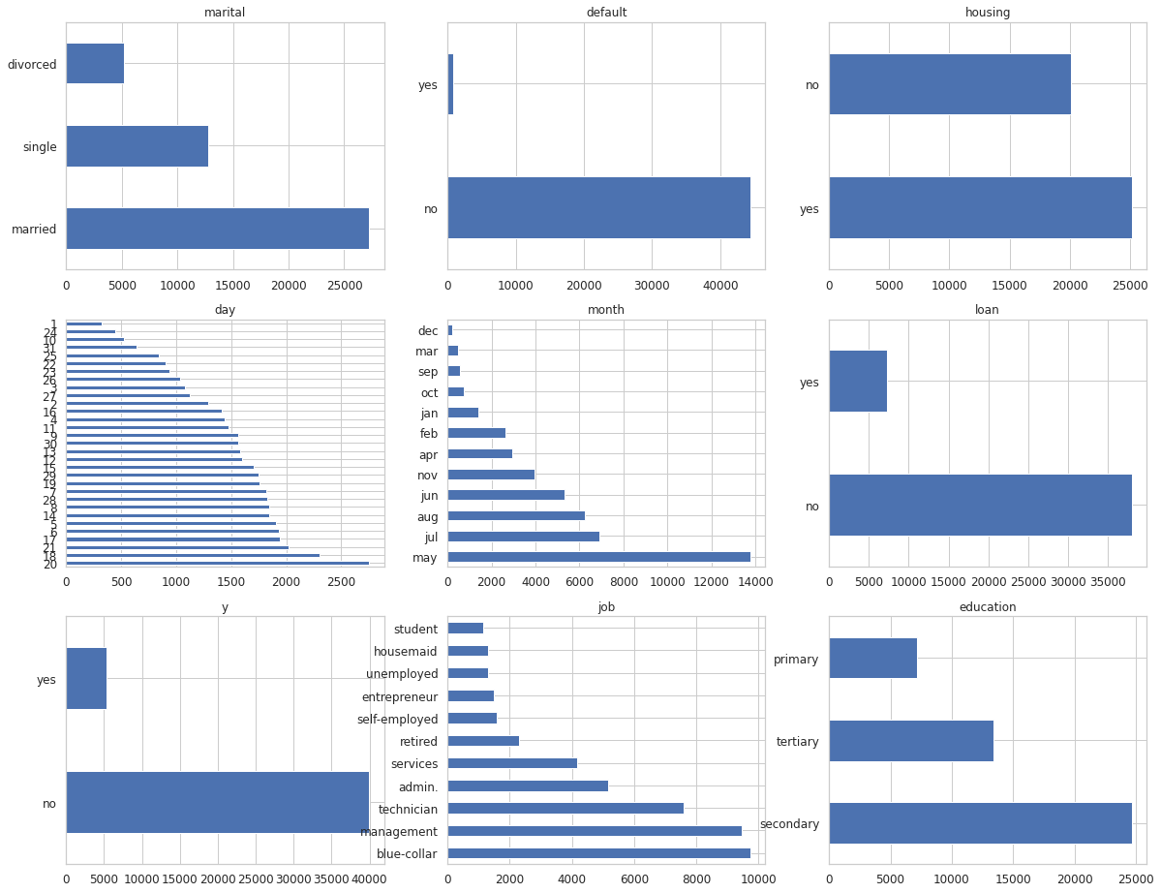
Exploratory Data
Analysis
Less number of students and more number of management and technician customers
Most of married customers
Most customers education levels is secondary
Most customers are not defaulted in past
More than 50% have taken housing loan
Nearly 85% have taken personal loan
Major communication type is cellular
Most of the customers were last contacted in the month of May
Most customers where not contacted in previous month

Slide 11
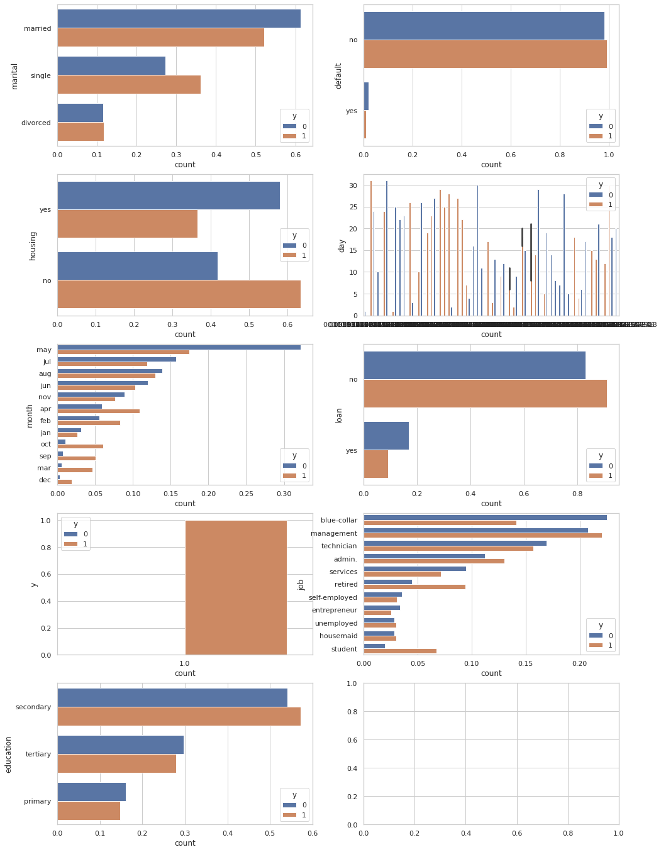
Exploratory Data
Analysis
Management, retire, self-employed, unemployed and students tend to subscribe more
Singles subscribe more than married and divorced
Customers with tertiary level of education will subscribe
Customers with without housing and personal loan tend to subscribe to team deposit
Customers approached by cellular communication have subscribed
Subscription rate is more during start(jan,feb,march,apr) and end of the year(oct,sept,dec)
Customers who subscribed during previous campaign tend to subscribe more.

Slide 12
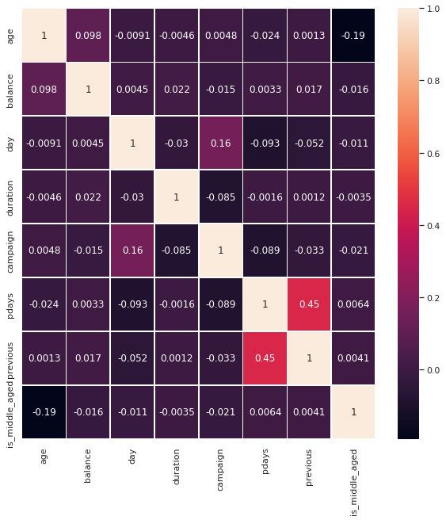
Exploratory Data Analysis
From the correlation matrix, there seems to be strong correlation between the features p_days and previous. We can verify that using hypothesis test.

Slide 13
Exploratory
Data Analysis
Summary
The following variables showed relationships with the target variable:
housing
age
marital
default
education
loan
contact
education

Slide 14
Random Forest Algorithm Working
Step 1: Select random samples from a given data or training set.
Step 2: This algorithm will construct a decision tree for every training data.
Step 3: Voting will take place by averaging the decision tree.
Step 4: Finally, select the most voted prediction result as the final prediction result.

Slide 15
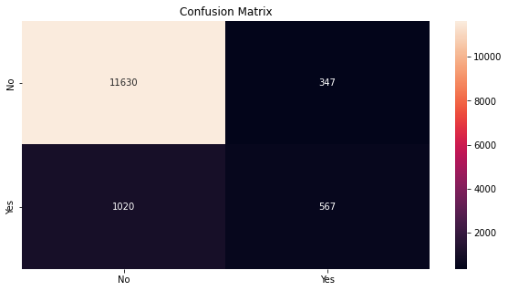
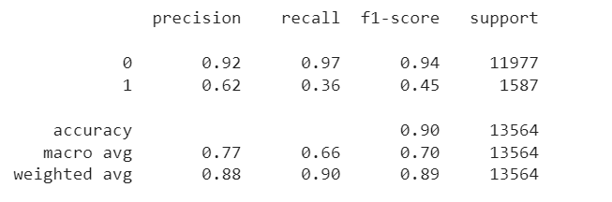
Random Forest Algorithm Result
The accuracy of the model is 90%. The misclassification rate of the model is 0.1.

Slide 16
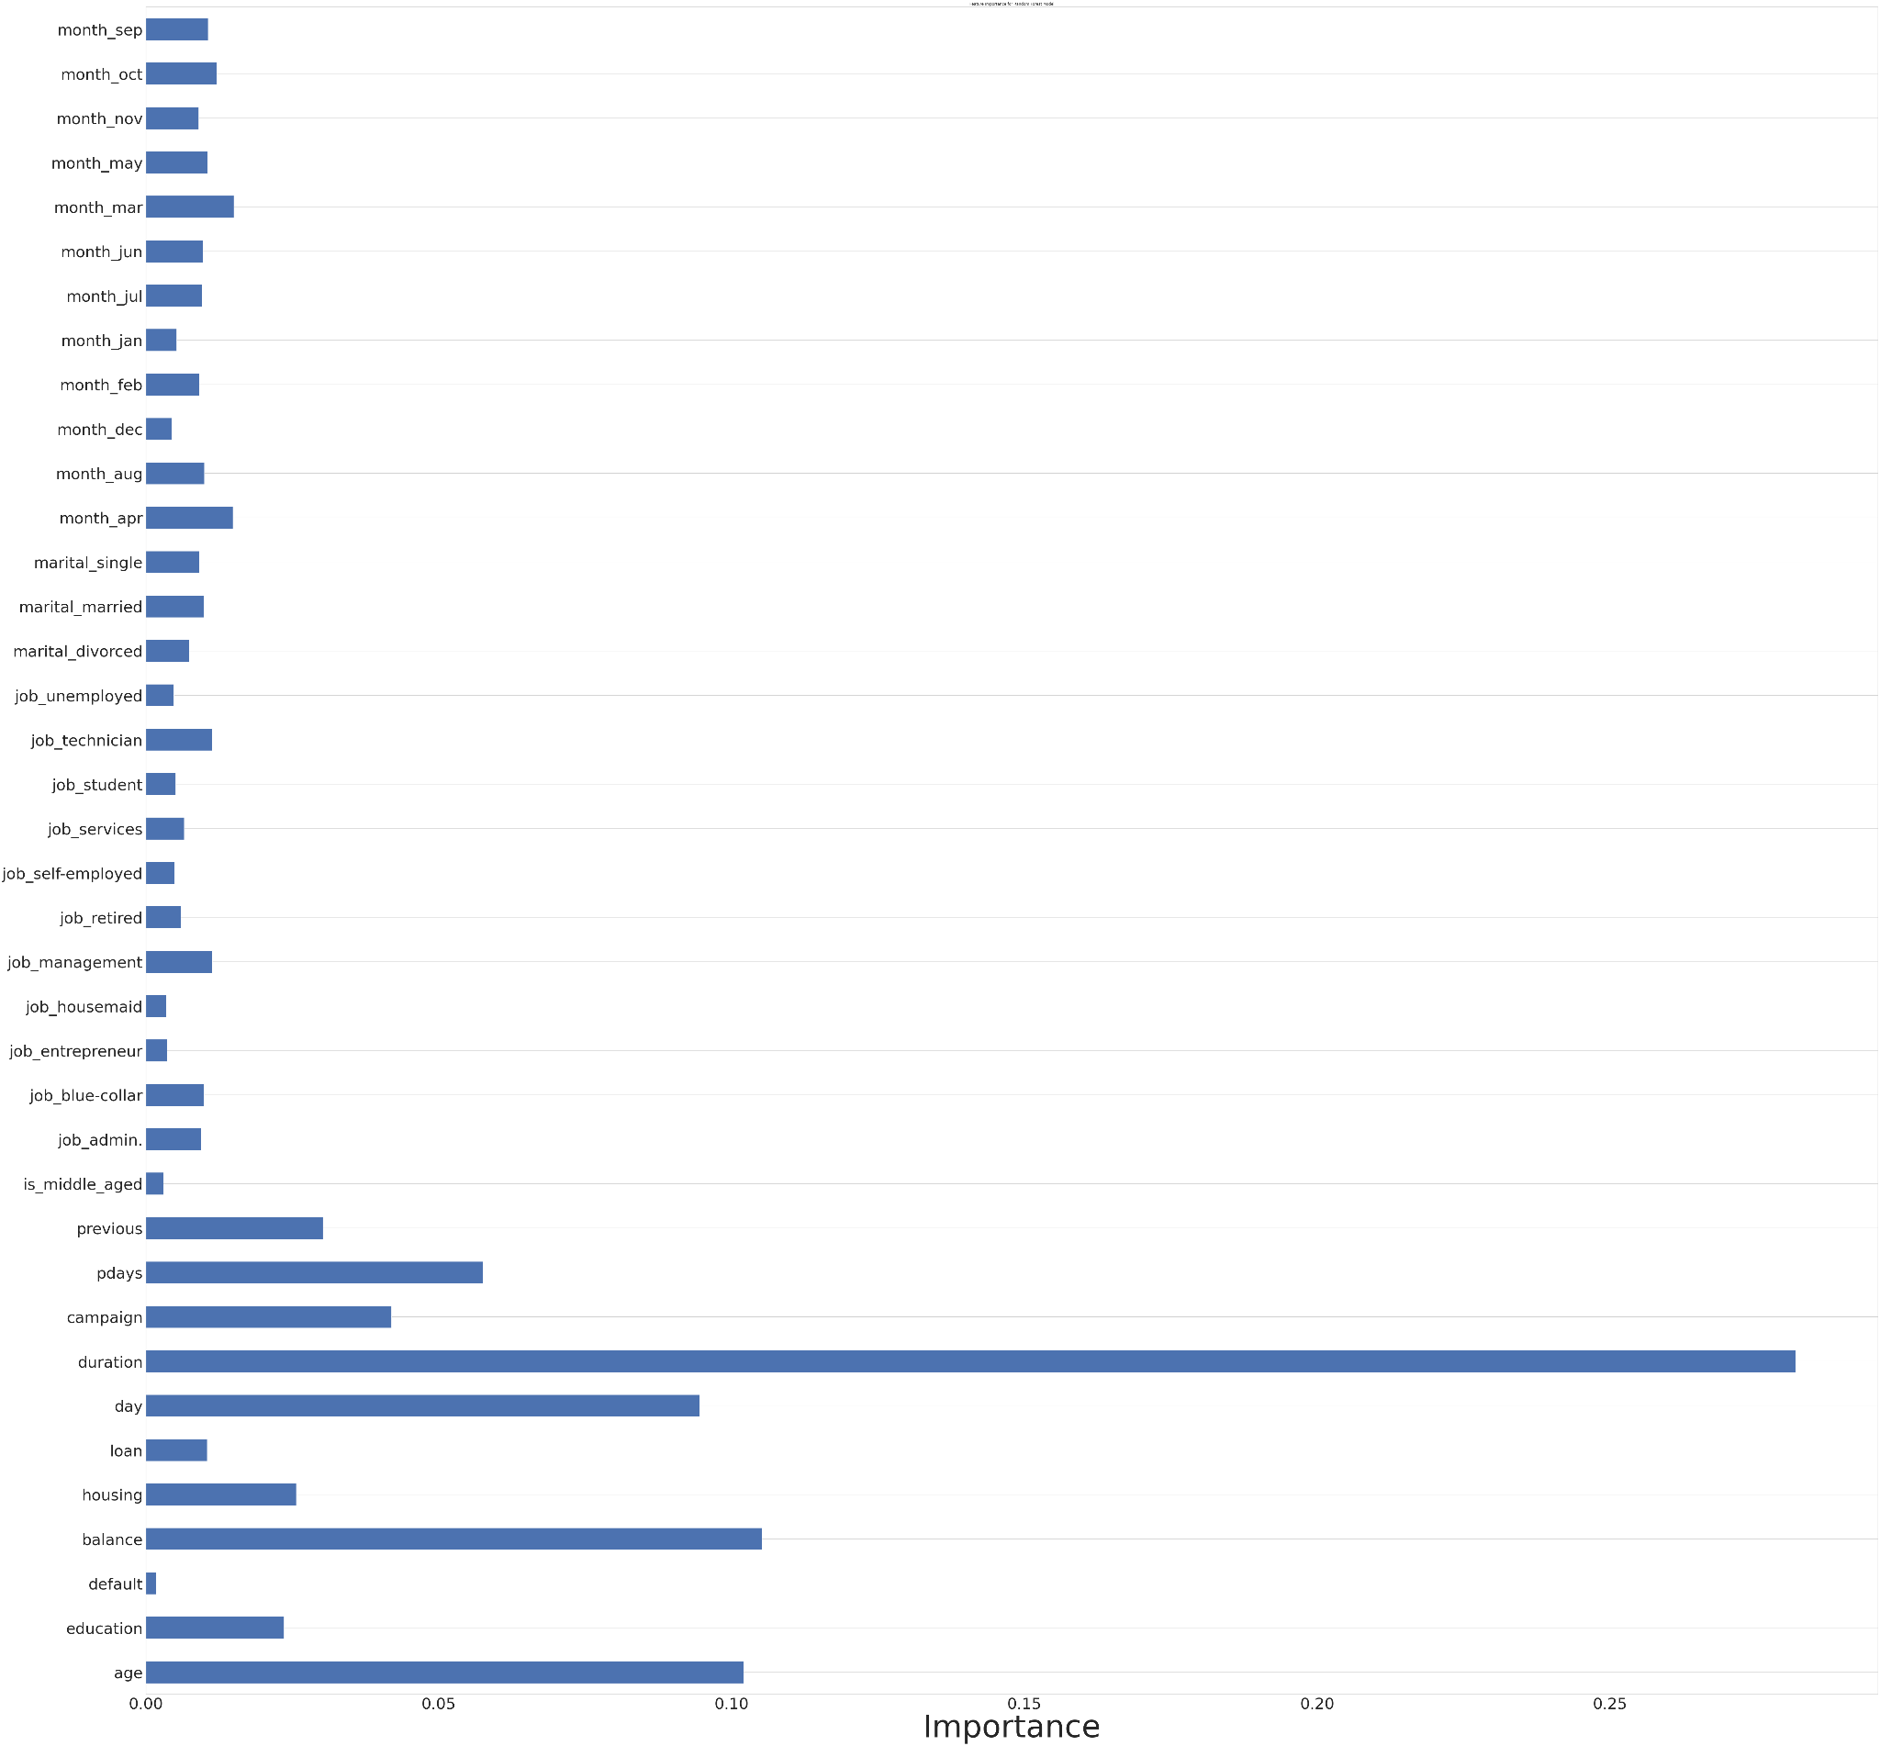
Feature
Importance

Slide 17
Model Recommendation
Recommendations for demographics:
under the age of 23 or middle aged
married customers
individuals who have not defaulted in the past
those who have taken out a personal loan
those who were not contacted the previous month
people with job titles / statuses such as management, retired, self-employed
those with secondary or tertiary education
customers who subscribed during a previous campaign
Recommended approach
cellular
during the start or end of the year (October - April)

Slide 18
Thank You

